Slide 1
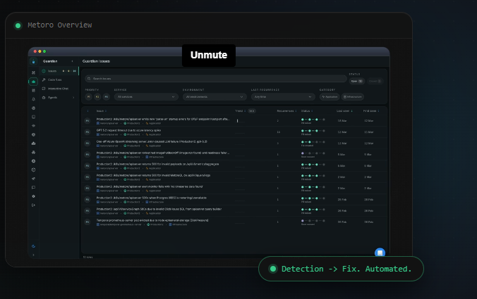

OpSimTech
Problem How it works Industries Products Method Cases
The Physics-AI Layer For Industrial Decisions
OpSimTech builds real-time digital twins that fuse high-fidelity physics simulation with AI — delivering the speed of machine learning with the trustworthiness of engineering science.
We engineer the right Physics-AI method for your application
PINNs where physics constraints allow, surrogates where they don't.

Slide 2
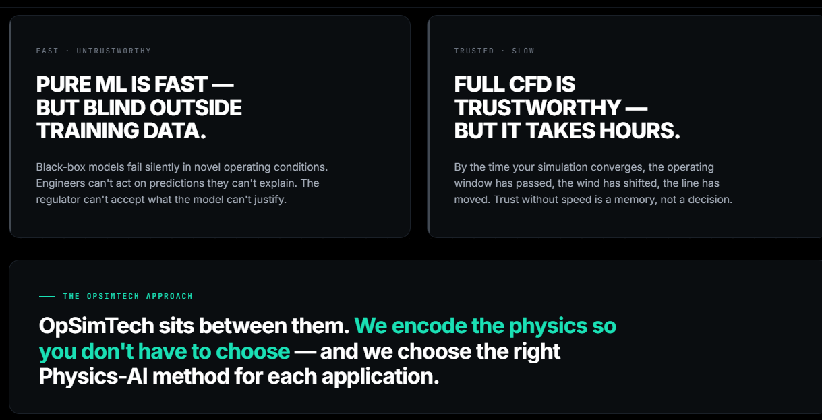
1- The Problem
The problem with fast models. And slow ones.
Industry has been forced to choose between two bad options. We built OpSimTech because neither is good enough alone.

Slide 3
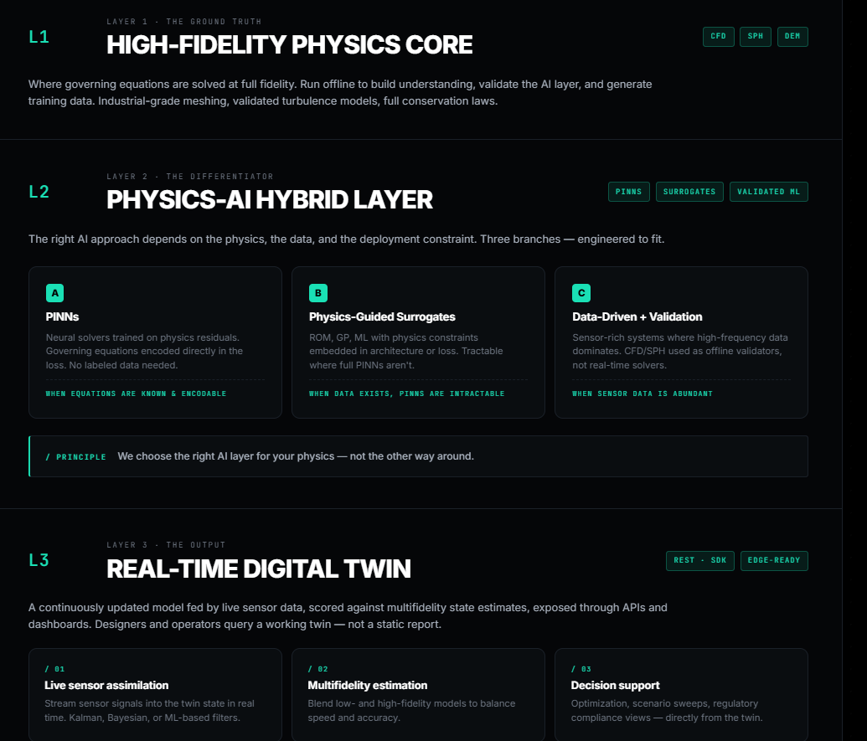
02 — How it works
The OpSimTech Physics-AI Stack. A three-layer architecture. The ground truth is physics. The acceleration layer is AI. The output is a digital twin
tips: for each layer like L2 and L3, I need to have graphical and professional cards containing a photo defining each subsection like CFd, SPH, DEM, PINNS, etc.. Why you put CFD.SPH, PINNS, etc in small fonts like tags? If not necessary for SEO, omit.

Slide 4
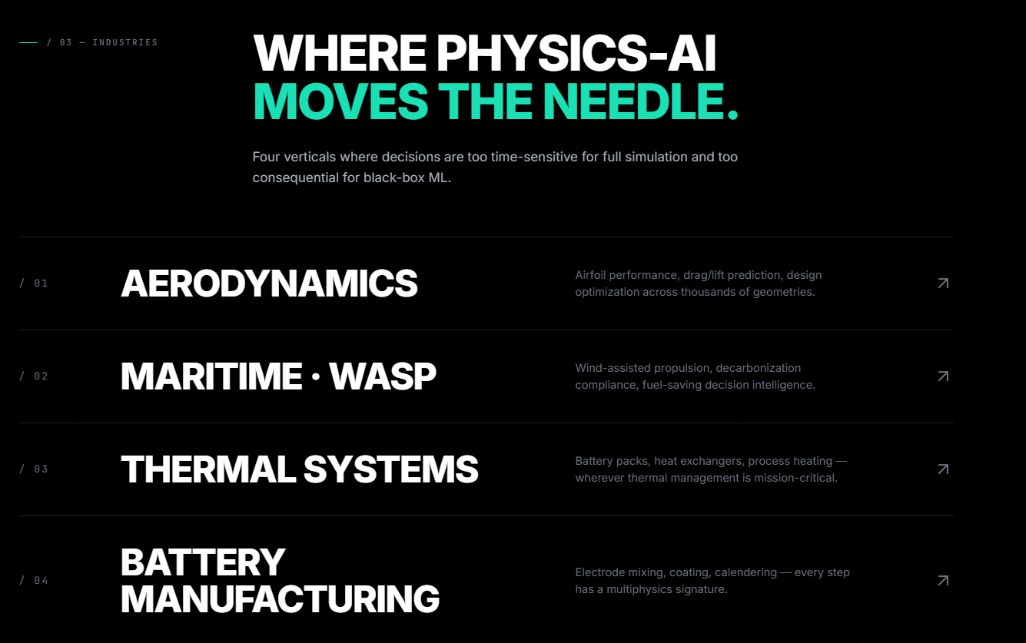
tips: for each section I need to put a background photo defining each

Slide 5
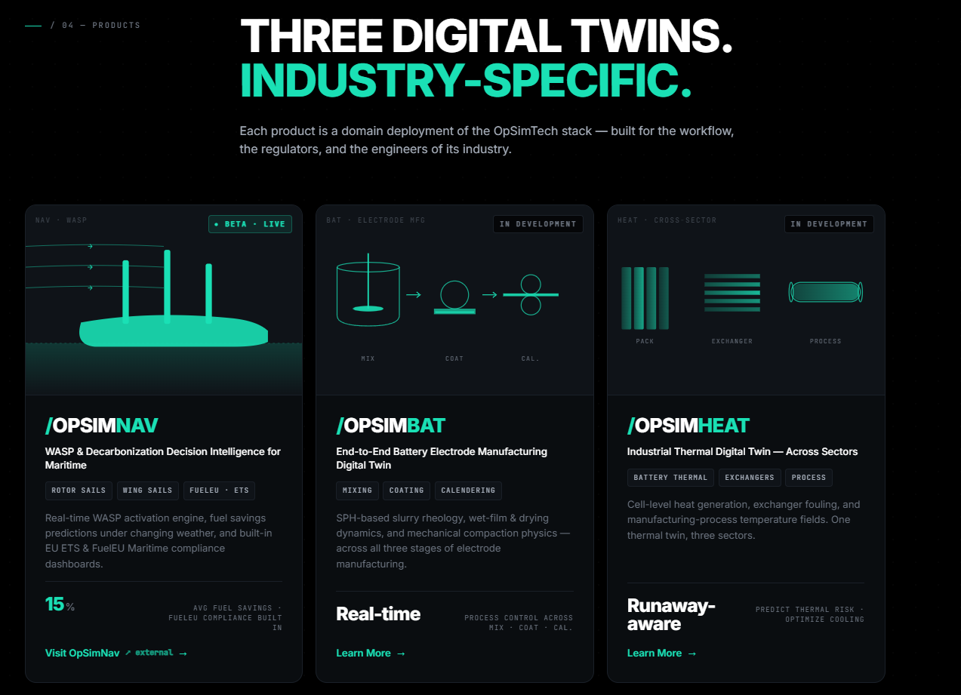
tips: in opsimbat, do not mention SPH-based. Write, Real-time digital twin for mixing, coating and calendaring process stages of electrode manufacturing based on CFD, SPH and DEM modeling results fused with sensor data (rephrase). I also need to have option of changing the photo for each card.

Slide 6
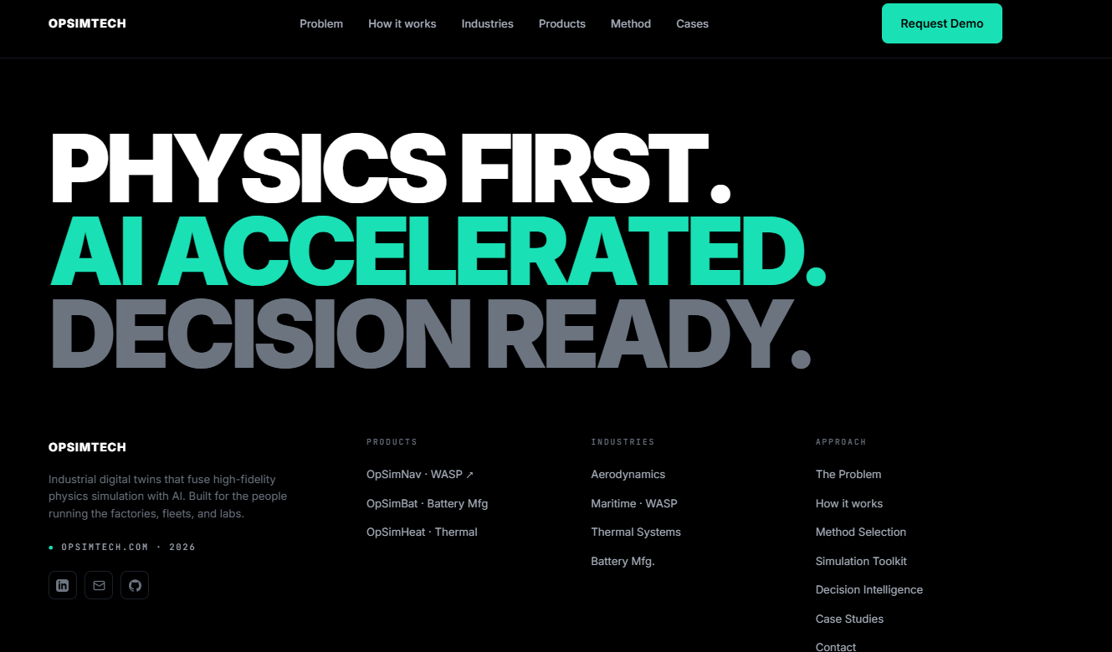
tips:
1- After defining digital twins (products), omit sections for “Physics-grounded. Decision-ready
“ “Real fleets. Real factories. Real numbers.“ and go to “Ready to build a digital twin engineers can trust?
“
2- we have “method”, “Our simulation toolkit” and “how it works” which are related to each other. I propose make a “explore more” button below the “how it works” section in the first page and transfer the method content to that page linked to this button.
3- make fonts reasonable look at the scales here.
4- make insights section with contents transferred from the current opsimtech website.

